Slide 1
Artificial Intelligence

Slide 2
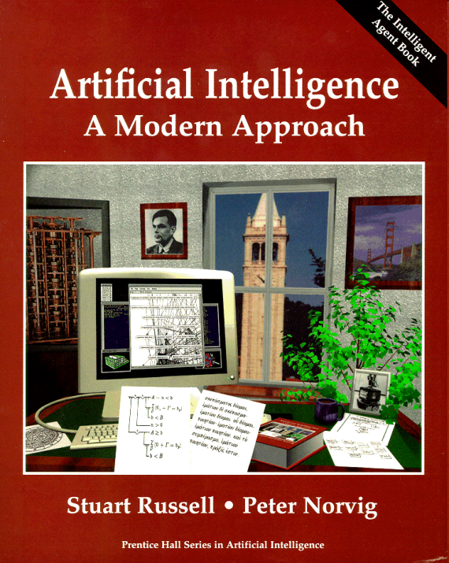
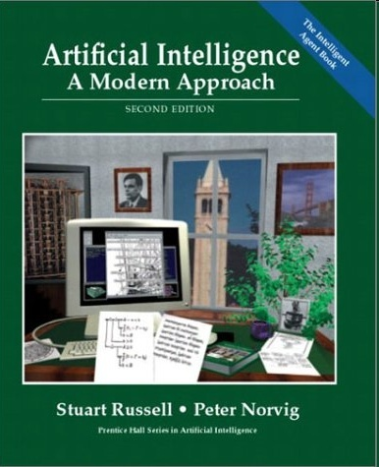
Referensi
Artificial Intelligence : A Modern Approach
http://aima.cs.berkeley.edu/

Slide 3
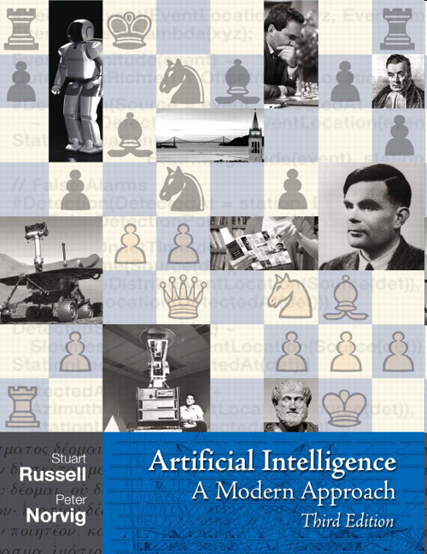

Slide 4
Story of cover …..

Slide 5
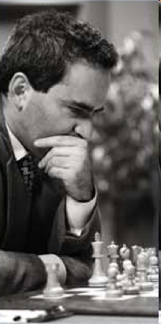
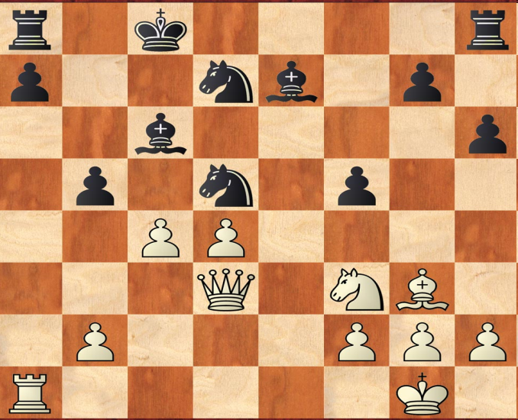
The Final Position from Game 6 of Kasparov vs. Deep Blue, 1997
Garry Kasparov, playing black, was forced to resign the decisive game 6, making this the first time a computer had beaten a world champion in a chess match. (Photo by Stan Honda/Getty Images.)

Slide 6
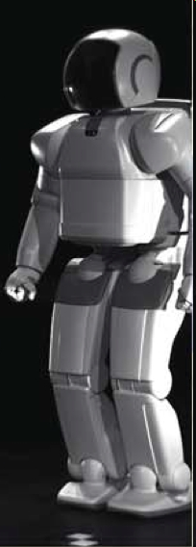
Sony Asimo Humanoid Robot
The robot's size was chosen to allow it to operate freely in the human living space and to make it people-friendly.
This size allows the robot to operate light switches and door knobs, and work at tables and work benches. Its eyes are located at the level of an adult's eyes when the adult is sitting in a chair. A height of 120cm makes it easy to communicate with.

Slide 7
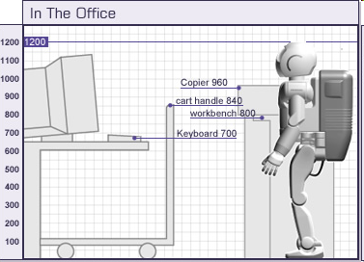
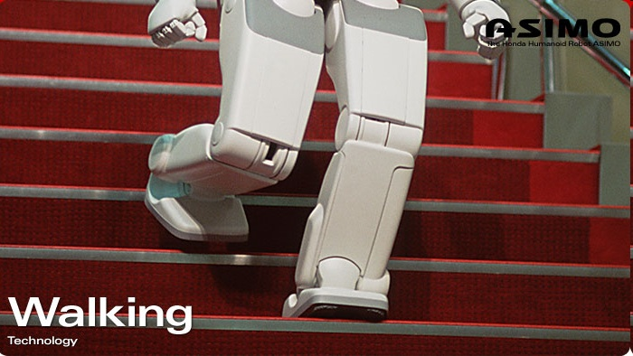
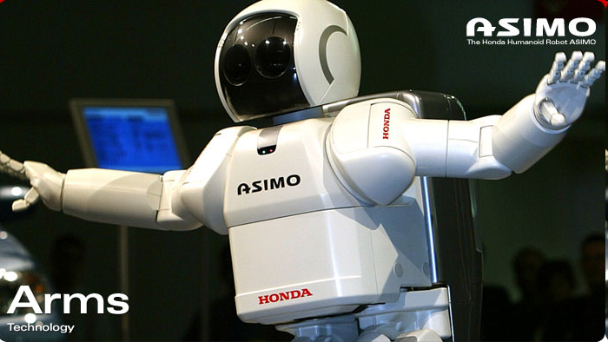
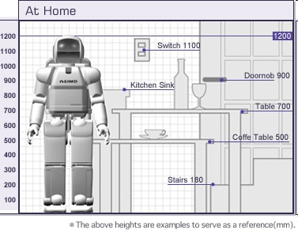
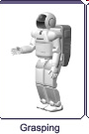
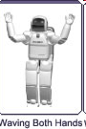
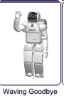
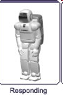

Slide 8
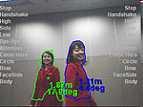
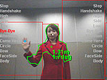
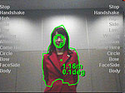
Sony Asimo
Intelligence Technology :
1. Recognition of moving objects
2. Posture/gesture recognition 3. Environment recognition 4. Sound recognition 5. Face recognition.
Network integration :
1. Integration with user's network system 2. Internet connectivity

Slide 9
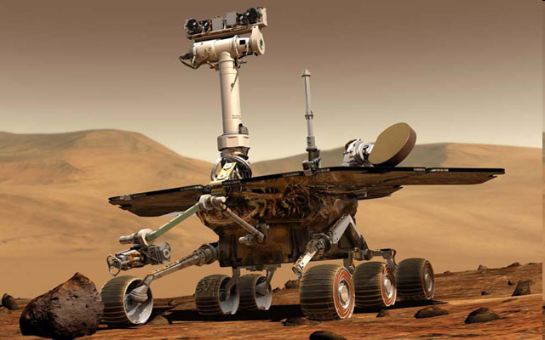
Mars Exploration Rover
The twin Mars Exploration Rovers, Spirit and Opportunity, are two of the most successful robots of all time. (Image courtesy of NASA.)

Slide 10
Mars Exploration Rover
NASA's twin robot geologists, the Mars Exploration Rovers, launched toward Mars on June 10 and July 7, 2003, in search of answers about the history of water on Mars. They landed on Mars January 3 and January 24 PST, 2004 (January 4 and January 25 UTC, 2004).
Primary among the mission's scientific goals is to search for and characterize a wide range of rocks and soils that hold clues to past water activity on Mars.

Slide 11
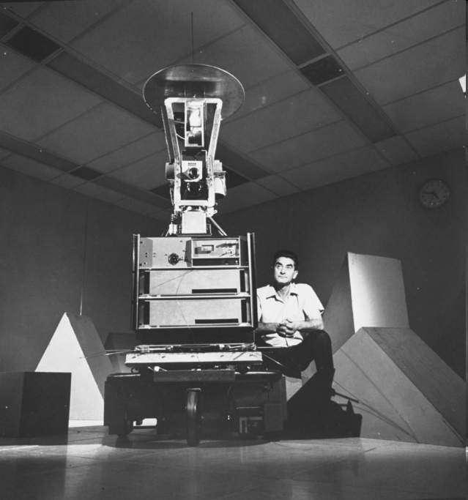
Shakey the Robot (1969-1973)
Shakey with project leader Charles Rosen. (Photo from Time Life/Getty.)

Slide 12
Shakey the Robot (1969-1973)
Shakey was the first mobile robot to reason about its actions. Developed by SRI's Artificial Intelligence Center from 1966 through 1972 (we were called the Stanford Research Institute at that time), Shakey has had a substantial legacy and influence on present-day artificial intelligence and robotics.
Shakey currently resides in the Computer History Museum in Mountain View, CA.

Slide 13
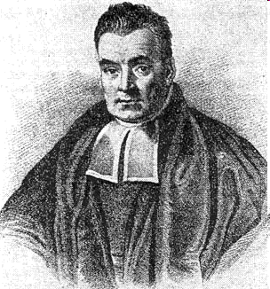
Thomas Bayes
Thomas Bayes (1702--1761), whose ideas about probability as a measure of belief underlie much of modern AI technology. (Image from Library of Congress.)

Slide 14
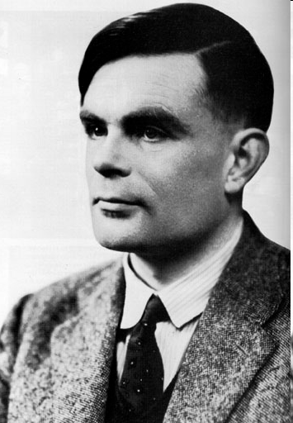
Alan Turing (1912-1954)
Alan Turing, who described the Turing Test and did fundamental work in Artificial Intelligence and the theory of computation. (Photo from Time Life/Getty.)

Slide 15
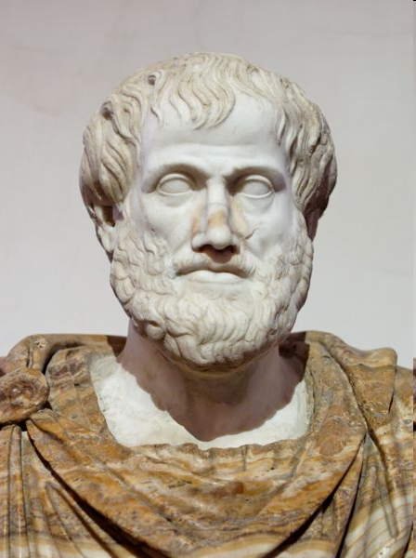
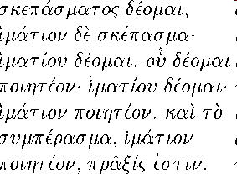
Aristotle (384 BC - 322 BC) and a Planning Algorithm from his De Motu Animalium

Slide 16
Rough translation:
But how does it happen that thinking is sometimes accompanied by action and sometimes not, sometimes by motion, and sometimes not? It looks as if almost the same thing happens as in the case of reasoning and making inferences about unchanging objects. But in that case the end is a speculative proposition ... whereas here the conclusion which results from the two premises is an action. ... I need covering; a cloak is a covering. I need a cloak. What I need, I have to make; I need a cloak. I have to make a cloak. And the conclusion, the ``I have to make a cloak,'' is an action.
(Bust from National Museum of Rome.)

Slide 17
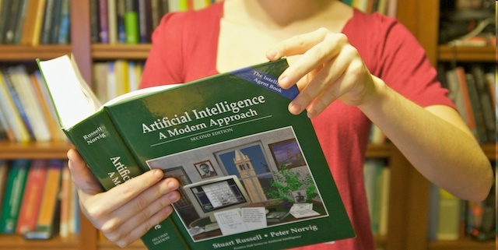
AIMA
Here is the original picture before the third edition cover was photoshopped in. (Photo by Peter Norvig. Model: Bella Norvig.)

Slide 18
Key question …
WHAT is INTELLIGENCE ?
What is ARTIFICIAL INTELLIGENCE ?

Slide 19
INTELLIGENCE
Dictionary definition
The ability to learn or understand or to deal with new or trying situations.
The ability to apply knowledge to manipulate one's environment or to think abstractly as measured by objective criteria (as tests)

Slide 20
Artificial Intelligence
Artificial Intelligence (AI) is the intelligence of machines and the branch of computer science which aims to create it.
Major AI textbooks define the field as "the study and design of intelligent agents”
John McCarthy, who coined the term in 1956, defines it as "the science and engineering of making intelligent machines."
Sumber : http://en.wikipedia.org/wiki/Artificial_intelligence

Slide 21
What is AI ?
 | Human Level | Rational
Behavior | Systems that behave/act like humans. (Turing Test, behaviorist approach) | Systems that act rationally. (most of modern AI)
Thinking | Systems that think like humans. (general problem solver - Tower of Hanoi) | Systems that think rationally. (expert systems, logic programs)

Slide 22
Acting humanly : Turing Test
Pada th. 1950, Alan Turing mengusulkan untuk menggantikan pertanyaan “Can machines think?” dengan “Can machines behave like humans?”
Turing mengusulkan suatu proses uji coba => Turing Test.

Slide 23
Acting humanly : Turing Test
Basic Test: (Abilities required to pass the Turing test)
Natural Language Processing
Knowledge Representation
Reasoning
Learning
Additional Subjects: (Requires physical interaction and needs perception and actuation )
Emotions, Characteristics
Vision
Speech recognition and production
Robotics

Slide 24
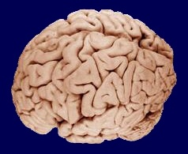
Thinking Humanly : Cognitive Science
Bagaimanakah manusia berpikir?
Perlu teori ilmiah mengenai proses internal dan
mekanisme otak berpikir dalam mengolah informasi/menyelesaikan masalah.
Ini dipelajari ilmu Cognitive Science dan Cognitive
Neuroscience :
to model internal activities of the brain.

Slide 25
Thinking rationally : Laws of thought
Facts and Rules in Formal Logic
Theorem Prover
Rational = Conclusions are provable from inputs and prior knowledge
Aristotle: what are correct arguments/thought processes?
Several Greek schools developed various forms of logic : notation and rules of derivation for

Slide 26
Thinking rationally : Laws of thought
Ahli matematika dan logika merumuskan notasi formal untuk menyatakan berbagai fakta tentang dunia:
Contoh :
“Si Budi itu yaa, apa aja dimakan deh!”
Budi menyenangi semua jenis makanan.
Notasi formal :
∀X : makanan(X) → menyenangi(Budi,X)
Problems :
* 1: Tidak mudah menyatakan pengetahuan informal dalam notasi formal.
*2: Mekanisme penalaran formal ini memiliki computational cost yang mahal.

Slide 27
Acting rationally : konsep agent
Rational behavior: doing the right thing
The right thing: that which is expected to maximize goal achievement, given the available information.
Rational agent: agent yang melakukan tindakan yang berakibat yang “terbaik”.
(Tidak harus melalui proses penalaran logika.)
Konsep inilah yang (menurut Russell & Norvig) menjadi konsep utama materi dari buku AIMA.

Slide 28
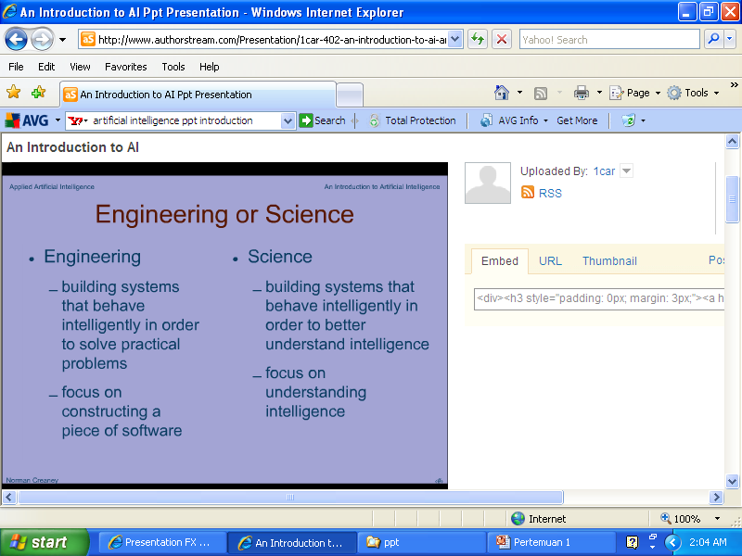
AI : Engineering vs Science

Slide 29
History of AI
1943 McCulloch & Pitts: Boolean circuit model of brain
1950 Turing's : “Computing Machinery and Intelligence"
1950s Early AI programs, including Samuel's checkers program,
Newell & Simon's Logic Theorist, Gelernter's Geometry Engine
1956 Dartmouth meeting: “Articial Intelligence" adopted
1965 Robinson's complete algorithm for logical reasoning
1966-74 AI discovers computational complexity
Neural network research almost disappears
1969-79 Early development of knowledge-based systems
1980-88 Expert systems industry booms
1988-93 Expert systems industry busts: “AI Winter"
1985-95 Neural networks return to popularity
1988- Resurgence of probability; general increase in technical depth
“Nouvelle AI": ALife, GAs, soft computing
1995- Agents, agents, everywhere : : :
2003- Human-level AI back on the agenda

Slide 30
AI Prehistory
Philosophy : logic, methods of reasoning
mind as physical system
foundations of learning, language, rationality
Mathematics : formal representation and proof
algorithms, computation, (un)decidability, (in)tractability
probability
Psychology : adaptation
phenomena of perception and motor control
experimental techniques (psychophysics, etc.)
Economics : formal theory of rational decisions
Linguistics : knowledge representation
grammar
Neuroscience : plastic physical substrate for mental activity
Control theory : homeostatic systems, stability
simple optimal agent designs

Slide 31
Topik AI
Knowledge Representation, Optimization & Reasoning
How do we represent knowledge about the world in a formal manner that can be manipulated in a sound and efficient manner?
Contoh : planning, scheduling, real-time problem solving
Search
How can an AI system go through all the possibilities in a systematic manner when looking for solutions to complex problems?
Contoh : game playing : othello, tic tac, toe; sudoku

Slide 32
Topik AI
Natural Language
How can a system communicate
in a natural language such as English ?
Contoh : Information retrieval, summarization, understanding, generation, translation
Machine Learning & Neural Network
How can a system learn from experience, or from past case data ?
Contoh : Data mining, text mining, neural network, genetic algorithm

Slide 33
Topik AI
Agents
How can we develop and use practical “intelligent agents”?
Contoh : intelligent assistants, internet agents
Machine Vision
Contoh : image analysis, recognition, scene understanding
Robotics
Contoh : grasping/manipulation, locomotion, motion planning, mapping

Slide 34
TERIMA KASIH

